Slide 1

Solar Power Generation Forecasting for Grid Management
SAI JASHAN (2420080045)
K.v.Aditya(2420080044)
Neeraj(2420080010)

Slide 2
Table of Contents
Problem Statement
Tasks
Datasets Description
Methodology
Task-1 Results
Task-2 Results
Task-3 Results
Conclusions

Slide 3
Problem Statement
Grid operators need accurate 24-hour-ahead solar power generation forecasts to balance supply and demand and reduce curtailment. Intermittent cloud cover and weather variability make solar forecasting challenging. Accurate probabilistic forecasts allow grid operators to schedule backup reserves appropriately, enabling higher renewable penetration.

Slide 4
Dataset/s Description
Dataset-1
Total no of Samples:2930
Training Samples:2344
Validation Samples:293
Testing Samples:239

Slide 5
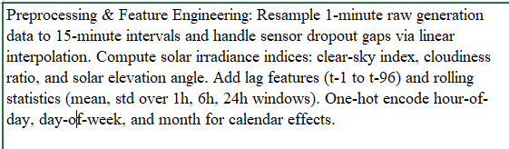
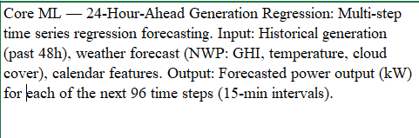
Tasks

Slide 6
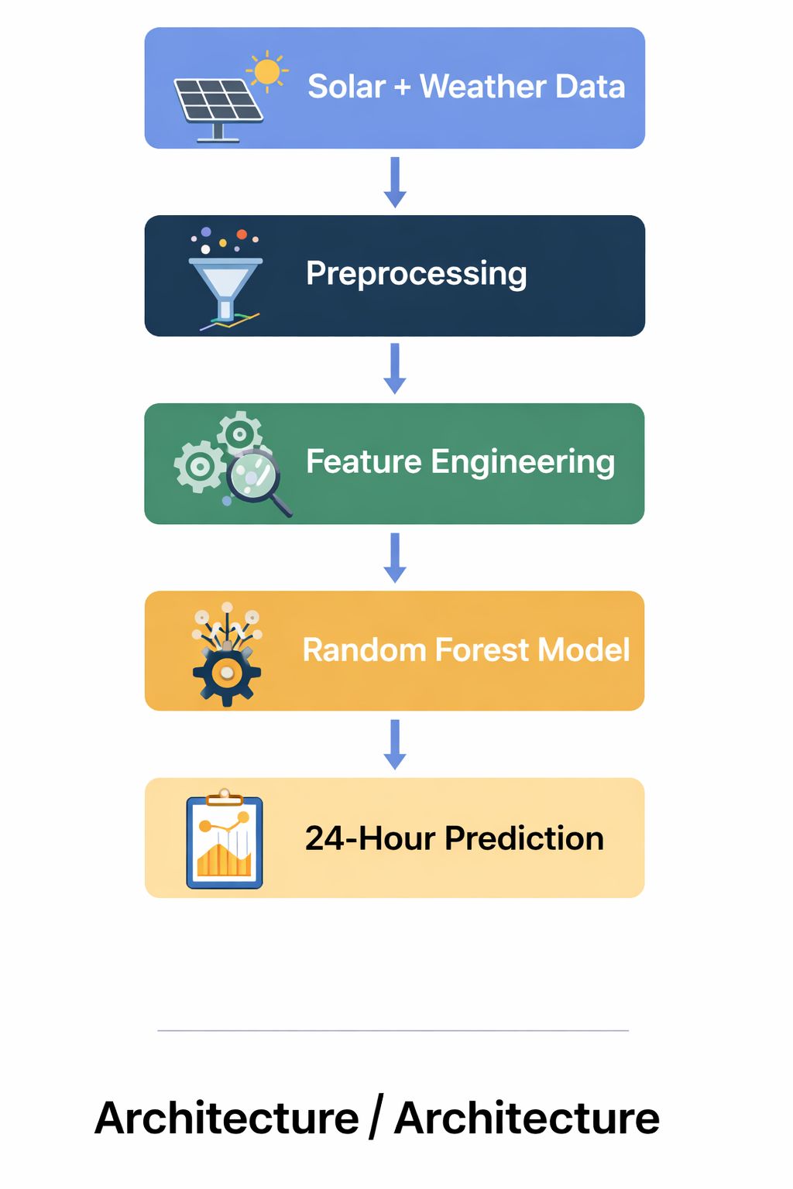
Methodology

Slide 7
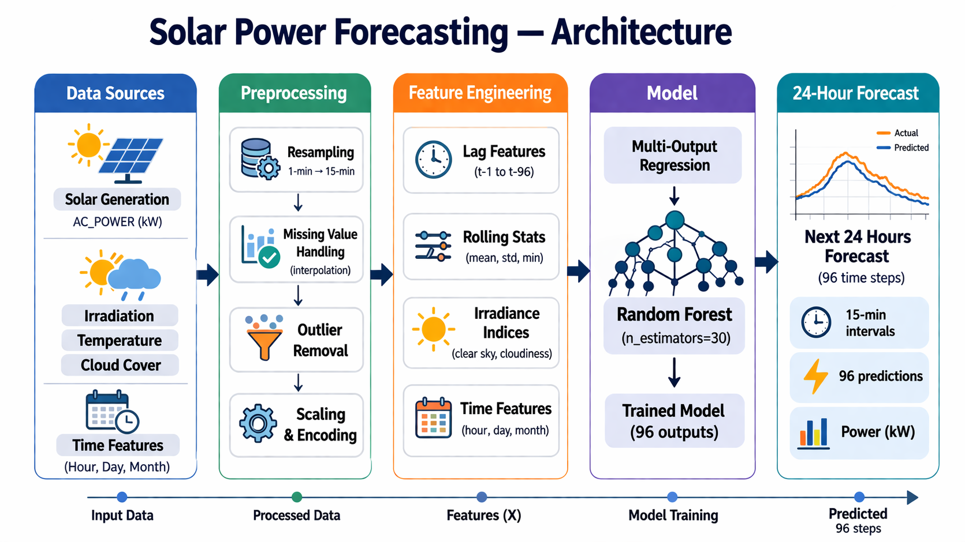
Methodology

Slide 8
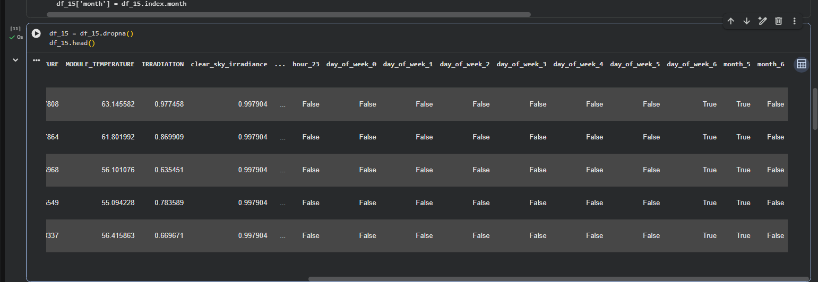
Task-1 Results

Slide 9
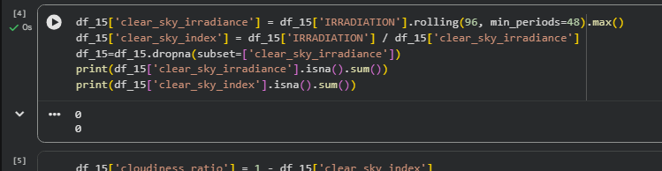
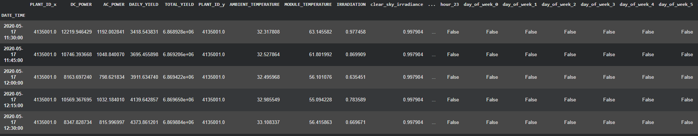

Slide 10
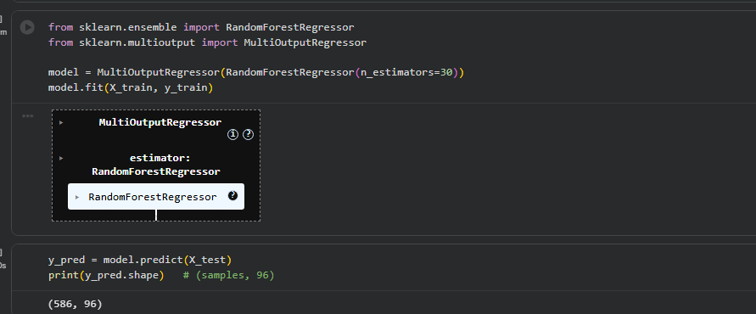
Task-2 Results

Slide 11
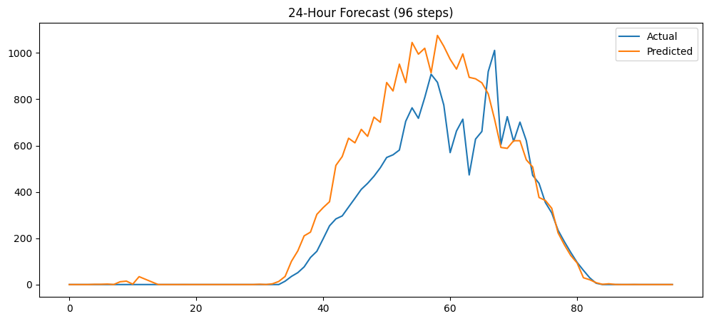
Task-2 Results

Slide 12
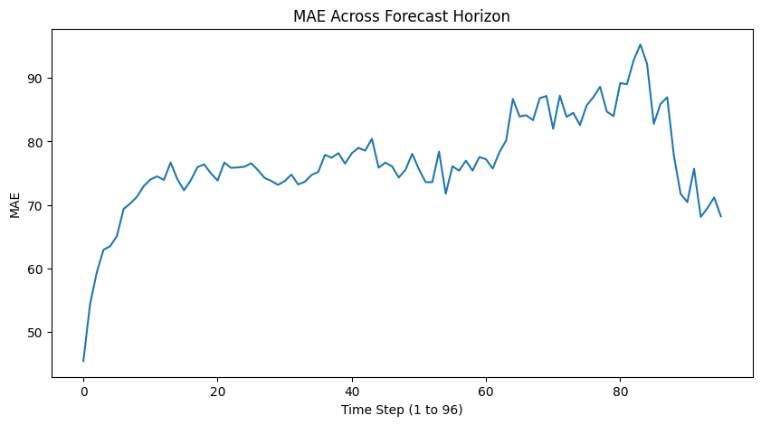
Task-2 Results

Slide 13
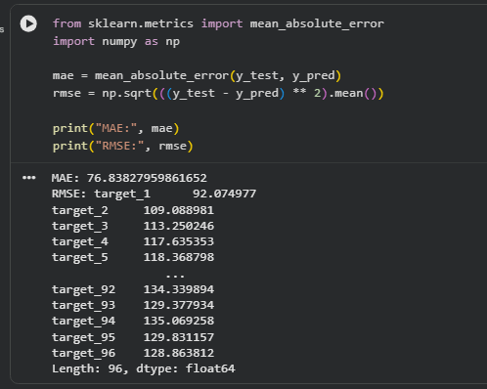
Task-3 Results

Slide 14
Conclusions
Developed a solar power forecasting model for 24-hour ahead prediction
Successfully transformed time-series data into a supervised learning problem
Used feature engineering (lag, rolling, weather features) to improve performance
Implemented multi-output regression to predict 96 time steps simultaneously
Model captures solar patterns and weather dependency effectively
Achieved reliable performance using MAE and RMSE metrics points

Slide 15
Thank You

